Slide 1
Convolutional Neural Networks(CNN)

Slide 2
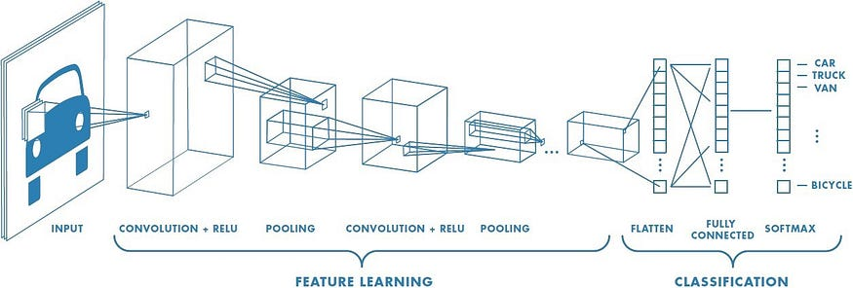

Slide 3
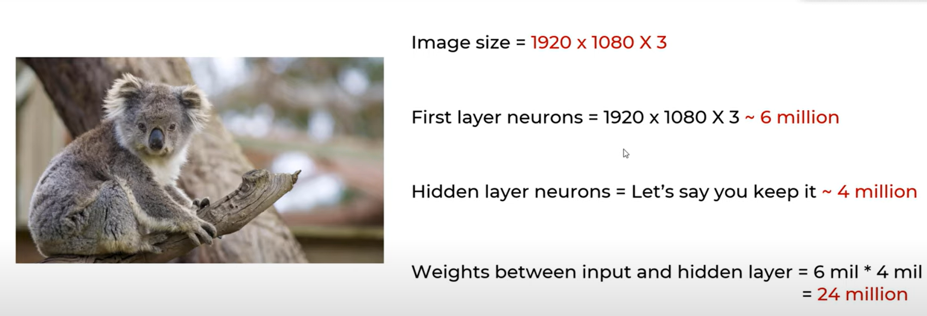

Slide 9



Slide 10
Max Pooling (Strides=2)

Slide 11
Max Pooling (Strides=1)

